Slide 1
Concept attainment lesson
Housing Styles

Slide 2
Focus on the visible house features
to identify the concept.
(Not a name for the style, but the features that make it an example of that style)

Slide 3
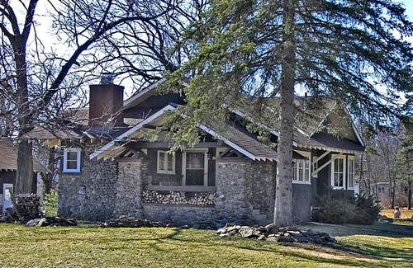
Yes

Slide 4
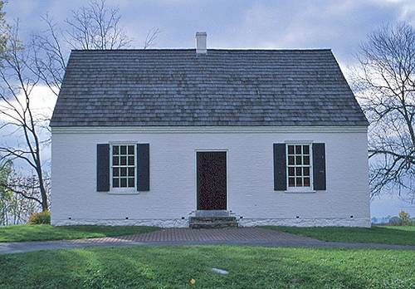
No

Slide 5
Develop a hypothesis:
Write down your thoughts on the following questions, then discuss with their partner:
  What attributes are similar between
  the two housing styles?
  What attributes are dissimilar?
What distinguishes the exemplar?

Slide 6
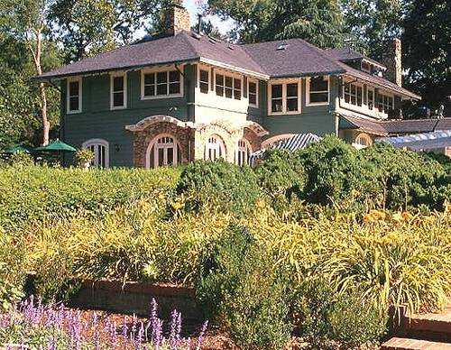
yes

Slide 7
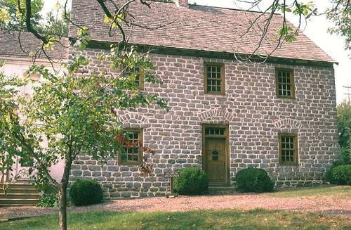
No

Slide 8
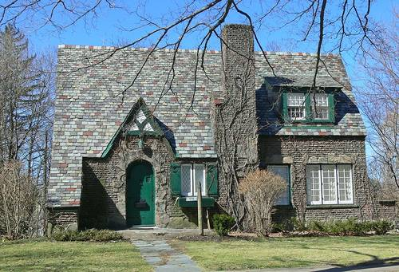
Yes or no? What features make you think so?

Slide 9
It was a no ☺

Slide 10
Now that you have a little more information, Write down the attributes you think describe this housing style.
Check with your partner – what ideas can you agree upon?
Do you have a firm hypothesis?
Let’s test it!

Slide 11
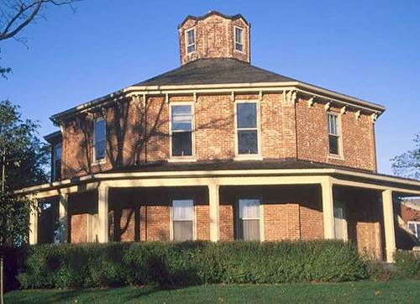
What do you think? Yes or no?

Slide 12
Another no!

Slide 13
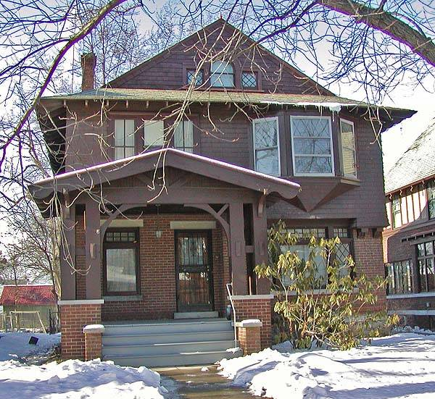
Yes

Slide 14
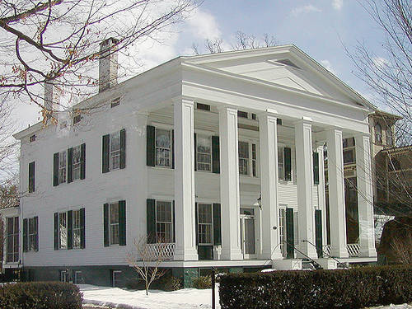
No

Slide 15
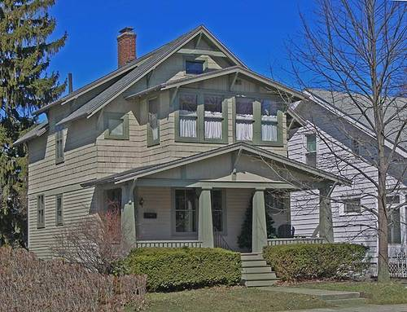
yes

Slide 16
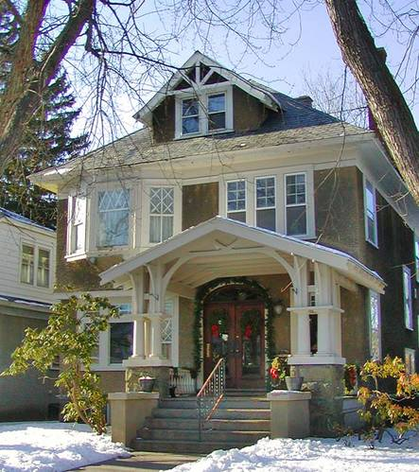
yes

Slide 17
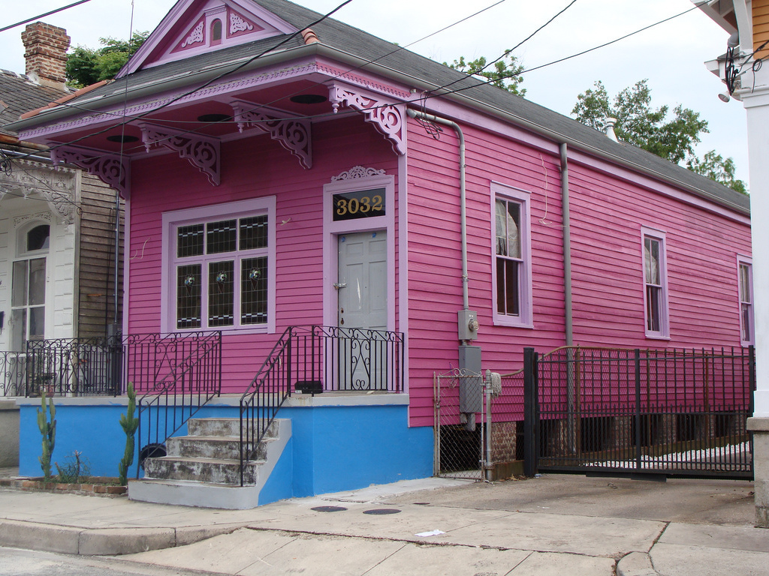
How about this one? Why?

Slide 18
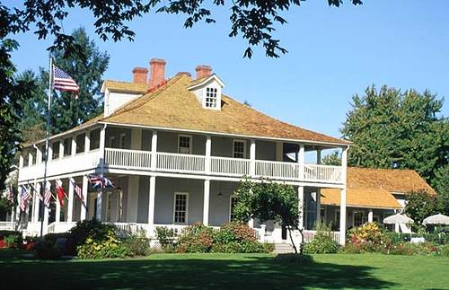
No

Slide 19
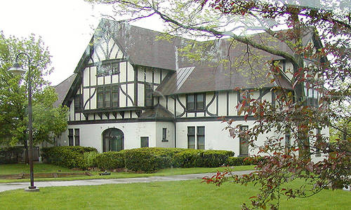
Yes or no?

Slide 20
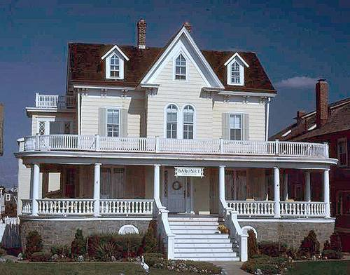
No

Slide 21
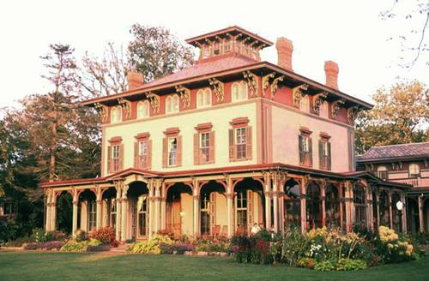
No

Slide 22
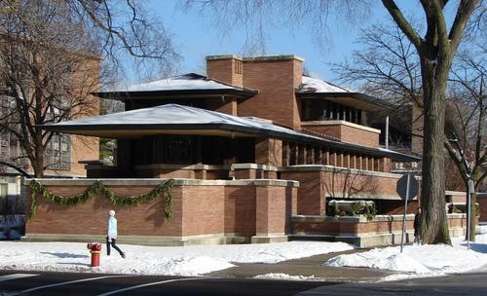
Yes or no?

Slide 23
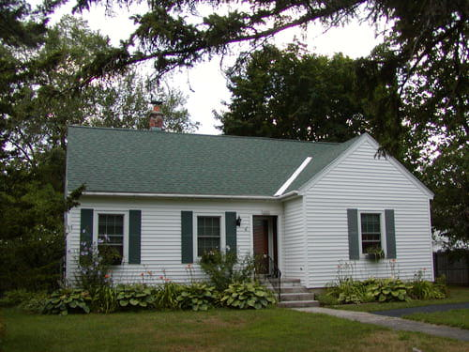
Yes or no? Why?

Slide 24
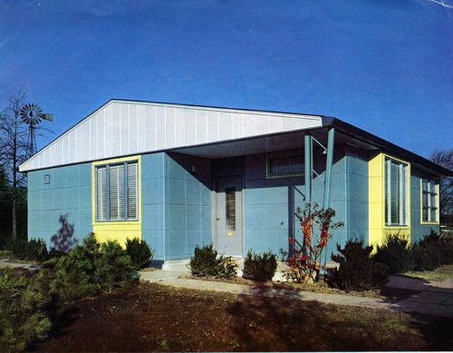
No

Slide 25
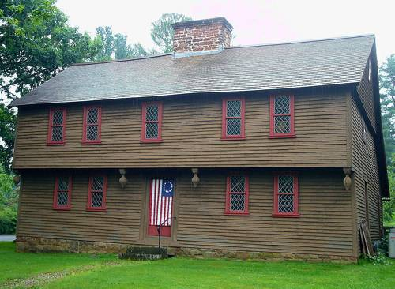
No

Slide 26
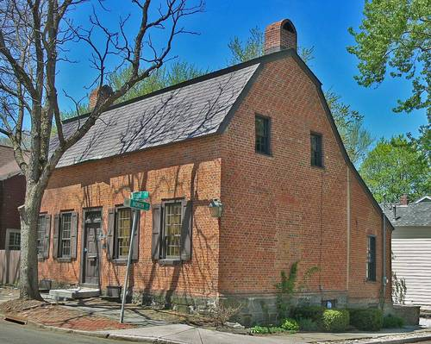
no

Slide 27
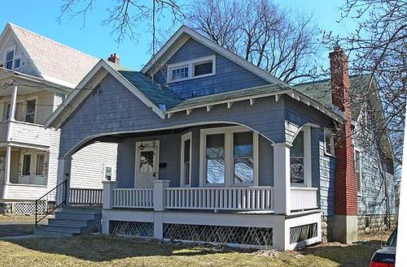
yes

Slide 28
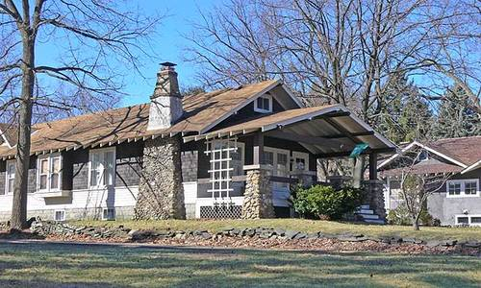
Yes

Slide 29
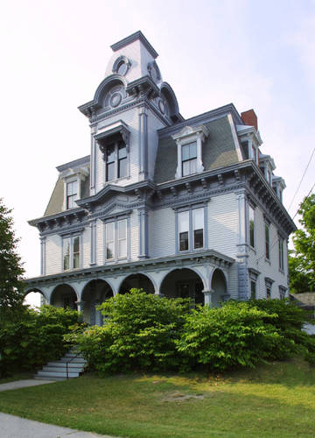
Yes or no?

Slide 30
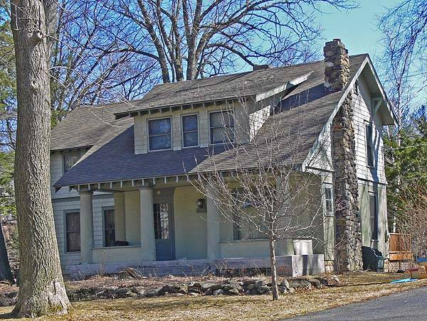
Yes or no?

Slide 31
It is a yes!
Features of “YES” examples
Exterior:
Wood, stone, or stucco siding
Low-pitched roof
Wide eaves with triangular brackets
Exposed roof rafters
Porch with thick square or round columns
Stone porch supports
Exterior chimney made with stone
Numerous windows
Some windows with stained or leaded glass

Slide 32
Give a name to the concept
(instructor or see if student’s know)
Arts and Crafts Style

Slide 33
Following the lesson, they can discover more common attributes of the style:
Interior:
Open floor plans; few hallways
Beamed ceilings
Dark wood wainscoting and moldings
Built-in cabinets, shelves, and seating

Slide 34
References
http://architecture.about.com/od/periodsstyles/ig/House-Styles/arts-crafts007.--2w.htm

